Slide 1
Playbook Workflow Generator (PWG)
By Tuhin & Zhenlin

Slide 2


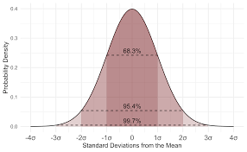
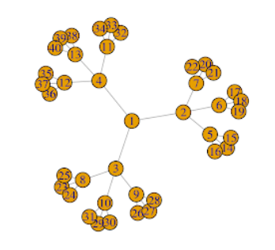


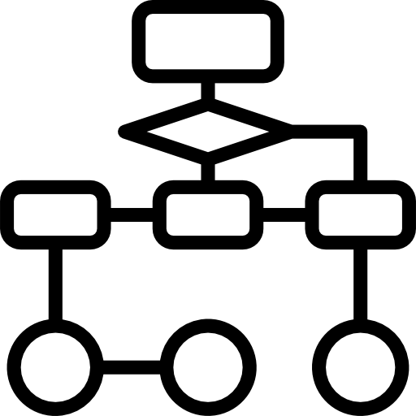

Overall Process

Slide 3
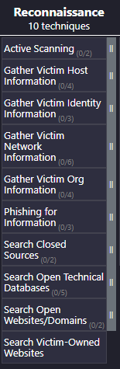
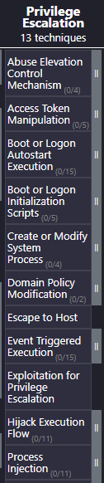
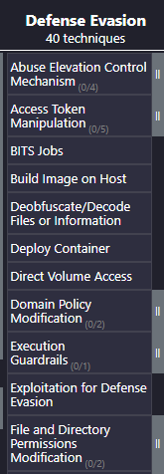
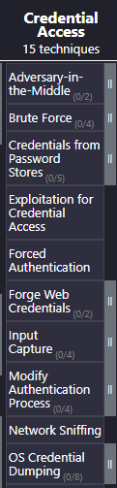
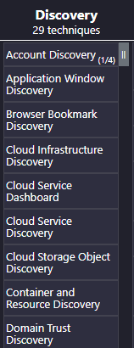
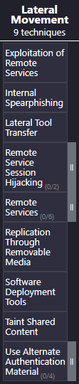
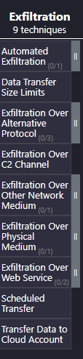
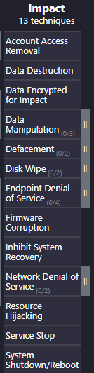
To Note
Tactic used for Data Theft
Tactic used for Unauthorized Access
--------
--------

Slide 4
Initial Method(a)
New Method(b)
Create New Case
Create New Case
Preprocess
Select Suspected Crime Type
Go to playbook page
Preprocess
Select a technique* based on user choice for crime type
Run Autogenerated Playbook(based on suspected crime type)
Displays Result
Displays Workflow + Result
* Technique associated with Credential Access or Data Theft Tactics

Slide 5
Method (a)
For autogeneration of playbook after creating a case and adding artefacts

Slide 6
Steps
Once user clicks on “Auto Playbook”, module in the backend checks for case’s “suspected crime type”, e.g. Data Theft.
--------
--------

Slide 7


2. Module checks for any TTP for this Tactic(Exfiltration). It sequentially scans the TTP in the list to detect if any TTP is detect. If not detected, keep moving to the next TTP.
a
b
c
d
--------
--------
e

Slide 8
e2
e6
e4
--------
e5
--------
e3
e
e1
3. Once a TTP is detected in the Exfiltration list, it then queries the associated TTPs using a tree graph generated by the module(part of the internal algorithm)

Slide 9
4. Continue with the same process as step 2.
a
b
c
d
--------
--------
e
f
g
h

Slide 10
h6
h1
--------
h5
--------
h2
h7
h3
h
h4
5. Continue with the same process as step 3.

Slide 11
6. Continue with the same process as step 2 and 4 until the end of the TTP queue is reached.
a
b
c
d
--------
--------
e
f
g
h

Slide 12

7. After reaching the end of queue, module returns a workflow of the detected TTP.
Data Theft
e
h
h2
h1
e2
e3
e1
h3
e4
During the scanning process, if the TTP associated in the tree graph is not detected, the subsequent TTP will not be scanned, allows quicker playbook runs.
h4
h5
e5
h6
e6
h7

Slide 13
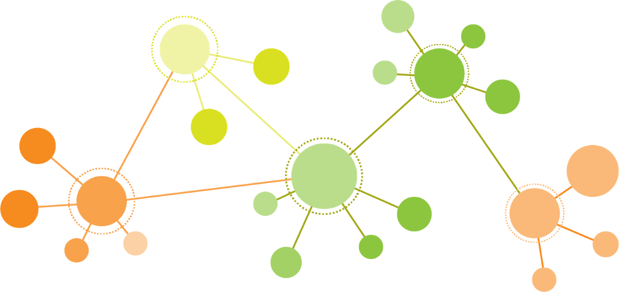
8. User can then view the result on the Knowledge Graph
T1
T4
T9
T6

Slide 14
Method (b)
For user based, customized playbook workflow selection from the playbook manager

Slide 15
1. User goes to the playbook manager and select a particular TTP(e.g. T1).
Steps
T8
T6
T1
T2
T13
T10
T9
--------
--------
T3
T11
T7
T4
T14
T12
2. Automatically generates a workflow related to the crimetype playbook selected based on next most relevant TTP to search(internal algorithm)

Slide 16
Generated flow(step 2) visualized
T1
T6
T2
T3
T4
T8
T9
T10
T11
T12
T13
T14

Slide 17
3. Starts TTP scan in a “depth first search” approach.
If the TTP is detected, it proceed
to check the subsequent TTP associated to it.
T1
T6
T2
T3
T4
T8
T9
T10
If the TTP is no detected, it does not proceed
to check the subsequent TTP associated to it.
T11
T12
T13
T14

Slide 18
4. User can then view the result on the Knowledge Graph
T1
T4
T9
T6

